Slide 1

Movie genre classification (Predicting movie genres from plot summary)
Abinayashree s v
Aishwarya g

Slide 2
abstract
Objective: To develop a predictive model that can classify movies into multiple genres based on their plot summaries using the movie_genres dataset.
Approach: The project encompasses data description, data cleaning and preprocessing , feature extraction, training several machine learning models(Logistic Regression, Naive Bayes, Support Vector Machine (SVM), Decision Tree, Random Forest, Gradient Boosting, Deep Learning models – LSTM) and evaluating their performance to determine the best model for accurate genre classification.
Outcome: The results provide a comparative analysis of various machine learning and deep learning models, identifying the most effective method for predicting movie genres. Finally select any one algorithm and make predictions using a new plot summary that is not present in the dataset.

Slide 3
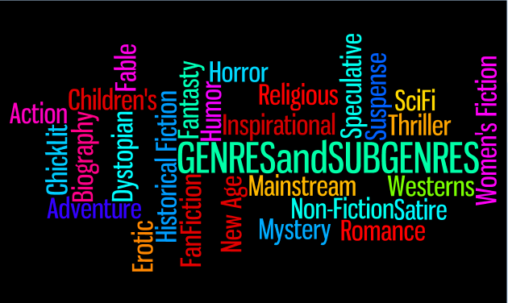
Introduction
Problem Statement: As the volume of movie content grows, efficient classification into genres aids in better organization, recommendation, and search functionalities.
Goal: Construct a robust model using the IMDb dataset that can predict the genre(s) of movies based on their plot summaries.
Importance: Accurate genre classification is essential for enhancing user experience on streaming platforms, enabling precise search results, and improving recommendation algorithms.

Slide 4
Technology Stack
Programming Language: Python
Python offers extensive libraries and frameworks for data manipulation, machine learning, and deep learning, making it ideal for this project.
Machine Learning Frameworks:
Scikit-learn: Provides efficient implementations of traditional machine learning algorithms and tools for model evaluation.
TensorFlow/Keras: Facilitates building and training complex deep learning models, particularly useful for handling sequential data.
Data Processing:
Pandas: Essential for data manipulation tasks such as loading, cleaning, and transforming data.
NLTK (Natural Language Toolkit): Offers tools for text processing, including tokenization, stemming, and lemmatization.
Feature Extraction:
Scikit-learn: Implements Bag of Words (BoW) and TF-IDF techniques for converting text data into numerical features.
Gensim: Provides models for word embeddings like Word2Vec and GloVe, capturing semantic relationships between words.

Slide 5
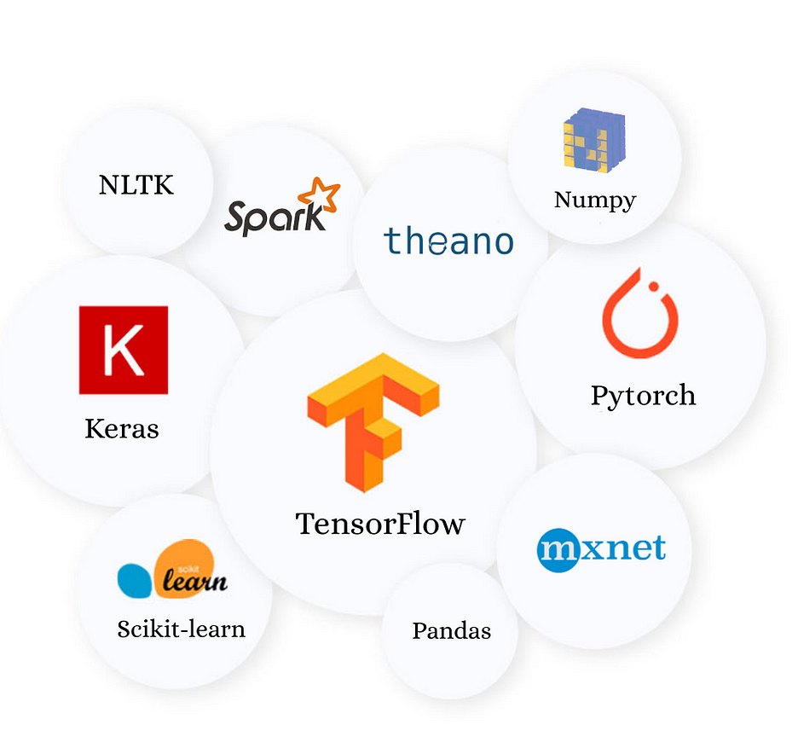
Libraries Used
Data Manipulation:
Pandas: For loading datasets, performing data cleaning, and preprocessing tasks.
Text Processing:
NLTK:
Tokenization: Converts text into individual words or tokens.
Stop-Words Removal: Filters out common words that do not contribute to meaning.
Stemming: Reduces words to their root form.
Lemmatization: Converts words to their base or dictionary form.
Regex: For cleaning text data by removing special characters and HTML tags.

Slide 6
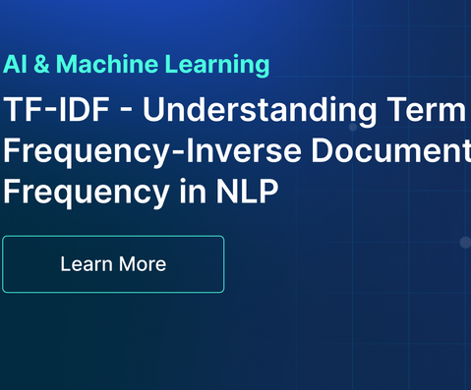
Libraries Used
Feature Extraction:
Scikit-learn:
Bag of Words (BoW): Represents text as a matrix of word counts.
TF-IDF: Measures term importance in a document relative to the entire corpus.
Gensim:
Word2Vec: Generates dense vector representations based on context.
GloVe: Provides vector representations based on global word co-occurrence statistics.

Slide 7

Dataset
Source: movie_genres dataset, accessible through sources like Kaggle or Github
Content Overview:
Plot Summaries: Narrative text that describes the movie’s plot.
Genres: Labels indicating the movie’s genre(s), often in a multi-label format (e.g., ["Action", "Adventure"]).
Example Data Entry:
Plot Summary: "In a dystopian future, a young woman discovers her hidden power and leads a revolution."
Genres: ["Action", "Sci-Fi", "Adventure"]

Slide 8

Number of Instances: Approximately 1,17,352 movies (exact number based on dataset).
Attributes:
Plot Summaries: Text attribute that provides detailed descriptions of movies.
Type: String
Genres: Categorical attribute indicating the genre(s) of each movie.
Type: List of Strings (e.g., ["Drama", "Romance"])
Describe the Dataset

Slide 9
Data Preprocessing
Cleaning:
HTML Tags Removal: Stripped HTML tags using BeautifulSoup or regex.
Special Characters Removal: Removed non-alphanumeric characters using regex.
Stop Words Removal: Removed common words that are not meaningful for classification.
Normalization:
Lowercasing: Converted all text to lowercase to ensure uniformity.
Tokenization: Split text into individual words or tokens.
Text Reduction:
Stemming: Reduced words to their root form.
Lemmatization: Reduced words to their base form.
Encoding Genres:
Binary Encoding: Converted genres into binary format for multi-label classification.
Example: Used multi-label binarizer to transform genres.

Slide 10
Feature Extraction
Bag of Words (BoW):
Description: Represents text by counting the frequency of each word in the document.
Advantages: Simple and effective for many text classification tasks.
TF-IDF (Term Frequency-Inverse Document Frequency):
Description: Reflects the importance of a word in a document relative to its occurrence in the entire dataset.
Advantages: Reduces the influence of common words and highlights important terms.
Word Embeddings:
Word2Vec:
Description: Learns vector representations of words based on their context within the corpus.
GloVe:
Description: Generates dense word vectors by analyzing word co-occurrence statistics.

Slide 11
Models Used
Logistic Regression:A linear model for binary and multi-label classification problems that is suitable for initial baseline comparisons.
Naive Bayes:Probabilistic model based on Bayes’ theorem with an assumption of feature independence.It Good for text classification, especially with a large number of features.
Support Vector Machine (SVM):Classifier that finds the hyperplane with the maximum margin between classes.SVM is effective in high-dimensional spaces and text classification.
Decision Tree:Tree-based model that splits data based on feature values to make predictions.It Easy to interpret but can be prone to overfitting.
Random Forest:Ensemble method that combines predictions from multiple decision trees to improve accuracy and reduce overfitting. This robust to overfitting and improves generalization.
Gradient Boosting:Sequential ensemble technique that builds models to correct the errors of previous models. GB Often achieves high performance but requires careful parameter tuning.
Deep Learning (LSTM):Recurrent neural network that is effective in learning long-term dependencies from sequences that is suitable for handling the sequential nature of text data.

Slide 12
Optimize Hyperparameters
Grid Search:
Description: Exhaustively searches through a predefined set of hyperparameters to find the optimal combination.
Advantages: Comprehensive but can be computationally expensive.
Random Search:
Description: Randomly samples from a range of hyperparameters, which can be more efficient than grid search.
Advantages: Faster and often sufficient for finding good hyperparameters.
Bayesian Optimization:
Description: Uses probabilistic models to optimize hyperparameters by balancing exploration and exploitation.
Advantages: Efficiently finds optimal parameters with fewer evaluations.

Slide 13
Train the Models
Procedure:
Data Splitting: To ensure our models generalize well to unseen data, we split the dataset into two parts: 80% for training and 20% for testing. This division allows us to train the models on a substantial portion of the data while reserving a separate set for evaluating their performance.
Training: Each machine learning algorithm is trained using the training set. During this phase, the models learn patterns and relationships within the data by minimizing a loss function that quantifies the difference between the predicted and actual genres.
Validation: To ensure the robustness of the models and prevent overfitting, cross-validation is employed. This technique involves splitting the training data into multiple subsets (folds). Each model is trained on several folds and validated on the remaining folds, ensuring that every data point is used for both training and validation. This process provides a reliable estimate of model performance and helps in fine-tuning the models.
Optimization: To enhance model performance, hyperparameters are tuned using various optimization techniques:
Grid Search
Random Search
Bayesian Optimization

Slide 14
Evaluate Model Performance
Metrics:
Accuracy: Percentage of correctly predicted genres out of the total predictions.
Example: Accuracy = (Number of Correct Predictions / Total Predictions) * 100%
Precision: Ratio of true positive predictions to the sum of true positives and false positives.
Example: Precision = True Positives / (True Positives + False Positives)
Recall: Ratio of true positive predictions to the sum of true positives and false negatives.
Example: Recall = True Positives / (True Positives + False Negatives)
F1-Score: Harmonic mean of precision and recall, providing a balance between the two.
Example: F1-Score = 2 * (Precision * Recall) / (Precision + Recall)
AUC-ROC: Area under the ROC curve, indicating the model's ability to distinguish between classes.
Example: AUC = Integral of the ROC curve.
Visualization:
Confusion Matrix: A matrix showing true vs. predicted classifications, with rows representing actual genres and columns representing predicted genres.
Example: A confusion matrix provides insights into model performance across different genres.

Slide 15
Analyze and Compare Models
Logistic Regression: Pros: Simple and interpretable; provides probabilities for each class.
Cons: May not capture complex relationships in the data.
Naive Bayes: Pros: Efficient and works well with high-dimensional data.
Cons: Assumes feature independence, which might not hold true for text data.
Support Vector Machine (SVM): Pros: Effective in high-dimensional spaces and for text classification.
Cons: Computationally expensive with large datasets.
Decision Tree: Pros: Easy to understand and interpret.
Cons: Prone to overfitting; less robust on its own.
Random Forest: Pros: Reduces overfitting by averaging multiple trees; robust to noise.
Cons: Can be less interpretable due to complexity.
Gradient Boosting: Pros: Often provides high accuracy and can handle complex relationships.
Cons: Requires careful tuning and can be computationally intensive.
LSTM: Pros: Captures sequential dependencies and context in text.
Cons: Resource-intensive and requires careful tuning of hyperparameters

Slide 16
Best Model Selection , Prediction and Application
Comparison Summary:
Best Performance: [Specify the model that performed best based on metrics such as accuracy, F1-score, AUC-ROC,etc.]
Reasons for Selection:
Performance Metrics: [e.g., Highest F1-score or AUC-ROC]
Practical Considerations: [e.g., Computational efficiency, ease of implementation]
Final Model: [Name of the selected model]
Rationale: Based on comparative analysis, this model demonstrated the best overall performance in predicting movie genres.
Prediction Process:
Input: Plot summaries of new or unseen movies.
Output: Predicted genres based on the trained model.
Application:
Integration: How the model can be integrated into movie recommendation systems or databases.
Real-World Use: Enhances user experience by providing genre predictions for movie browsing and recommendations.

Slide 17
Conclusion
Summary: Successfully developed and evaluated multiple models for movie genre classification using the IMDb dataset. Identified the best-performing model through rigorous testing and analysis.
Impact: Improved accuracy in genre prediction can significantly enhance movie recommendation systems and content organization.
Future Work:
Further Improvements: Explore advanced models, including transformers or other neural network architectures.
Additional Features: Incorporate more features like cast, director, or reviews to enhance prediction accuracy.

